Slide 1
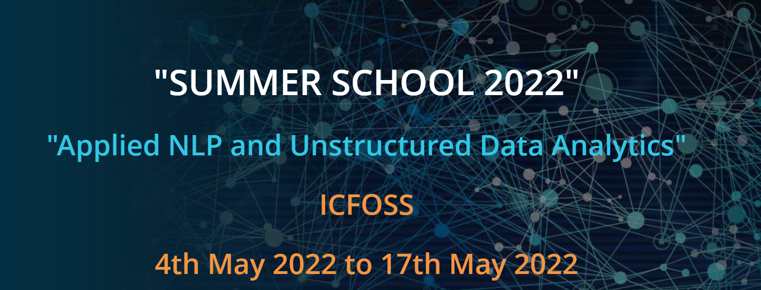
Project Prepared and Presented by:
Jayashree Nair
Rizwana Kallooravi Thandil
Vanichithra V
Project Guide: Deepu C
Research Associate,ICFOSS

Slide 2
Environmental Sound Recognition System

Slide 3

Introduction
Automatic Environmental Sound Classification / Recognition System.
ESRS
Sound Category: Dog, Laughing, Frog, Hen, Clapping…
Input Sound File

Slide 4
Development Pipeline
Data Acquisition
Pre-processing
Vectorization and Feature Engineering
ML Model(s) Creation and Evaluation
MLP Classifier, DecisionTree Classifier, SVM Classifier, RandomForest Classifier, KNN Classifier, SGD Classifier
Simple FNN using Keras and Tensorflow.
Tried with Pytorch.
Deployment
Streamlit

Slide 5
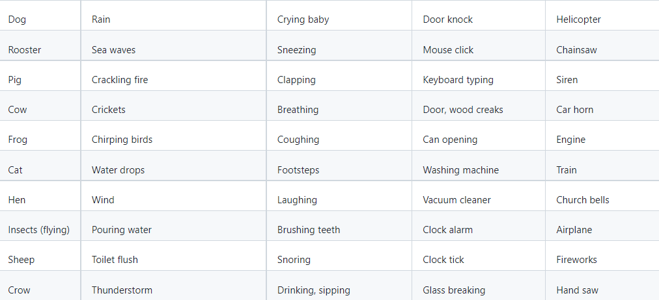
Data Acquisition
https://github.com/karolpiczak/ESC-50: is a labeled collection of 2000 environmental audio recordings.
The dataset has 5-second-long recordings organized into 50 semantical classes (with 40 examples per class).
K. J. Piczak. ESC: Dataset for Environmental Sound Classification. Proceedings of the 23rd Annual ACM Conference on Multimedia, Brisbane, Australia, 2015.

Slide 6
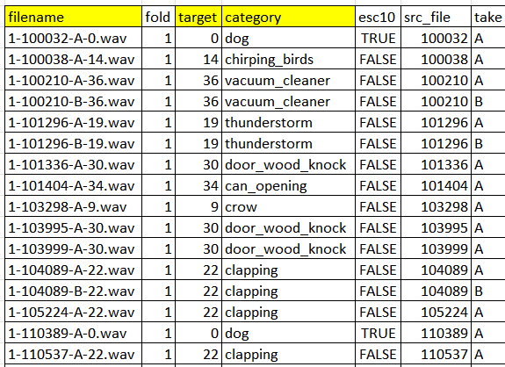
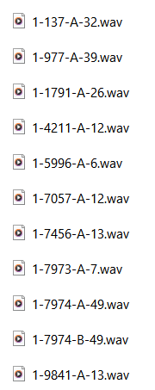
Dataset and audio files
audio files
csv file

Slide 7
Feature Engineering

Slide 8
Methodologies Adopted
Mel Frequency Cepstral Coefficients
Short Term Fourier Transformation
Mean Mel spectrogram

Slide 9


MFCC — Mel-Frequency Cepstral Coefficients
This feature is one of the most important method to extract a feature of an audio signal and is used majorly whenever working on audio signals.
The Mel frequency cepstral coefficients (MFCCs) of a signal are a small set of features (usually about 10–20) which concisely describe the overall shape of a spectral envelope.
40 features are extracted for the experiment

Slide 10
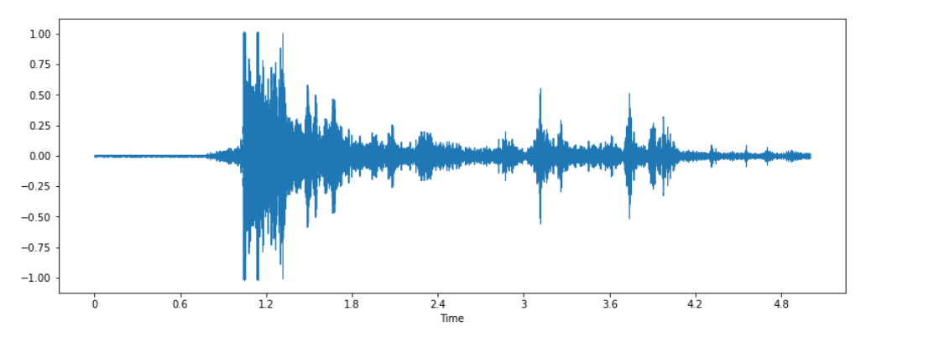
Speech Signal

Slide 11
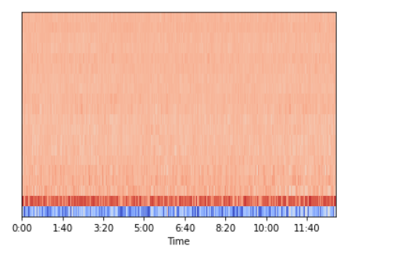
MFCCs

Slide 12
Short Term Fourier Transform.
STFT converts signal such that we can know the amplitude of given frequency at a given time.
Using STFT we can determine the amplitude of various frequencies playing at a given time of an audio signal.
12 features are extracted for the experiment.

Slide 13
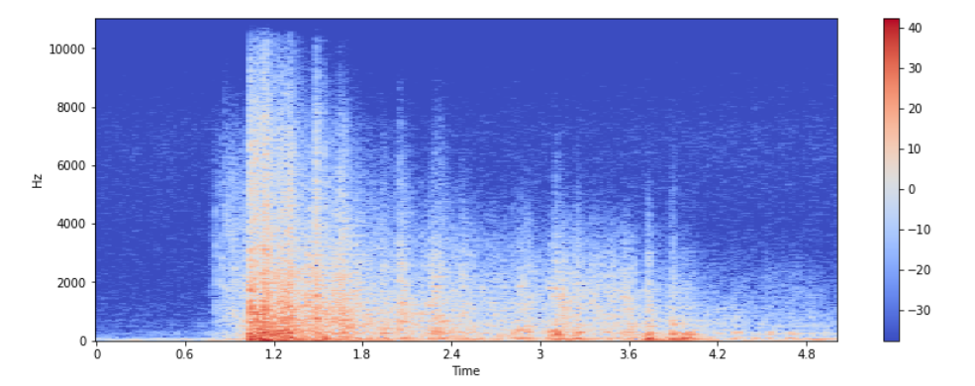

Slide 14
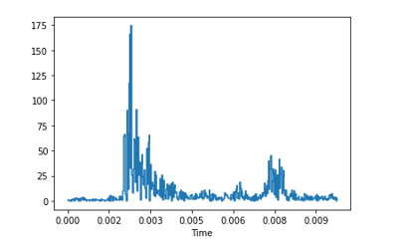

Slide 15




Mel Spectrogram
A spectrogram is a visualization of the frequency spectrum of a signal, where the frequency spectrum of a signal is the frequency range that is contained by the signal.
The Mel scale mimics how the human ear works, with research showing humans don’t perceive frequencies on a linear scale.
Humans are better at detecting differences at lower frequencies than at higher frequencies.
128 features are used in the experiment

Slide 16
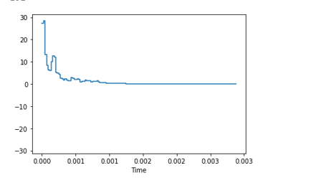

Slide 17
Totally
40+12+128=180 features are extracted

Slide 18
Model Creation and Evaluation

Slide 19
Model Evaluation Results
Model | Before Tuning | After Tuning (with GridSearchCV)
MLP Classifier | 92.00% (30 sec) | 94.50% (37 sec)
DecisionTree Classifier | 27.50% (398 ms) | 26.25% (43.6 sec)
SVM Classifier | 44.75% (533 msec) | 44% (14.7 sec)
RandomForest Classifier | 15.50% (424 msec) | 48.25% (6min)
KNN Classifier | 27.75% (986 u sec) | 43.00% (10 min)
SGD Classifier | 21.25% (21 msec) | 25.75% (50 sec)

Slide 20
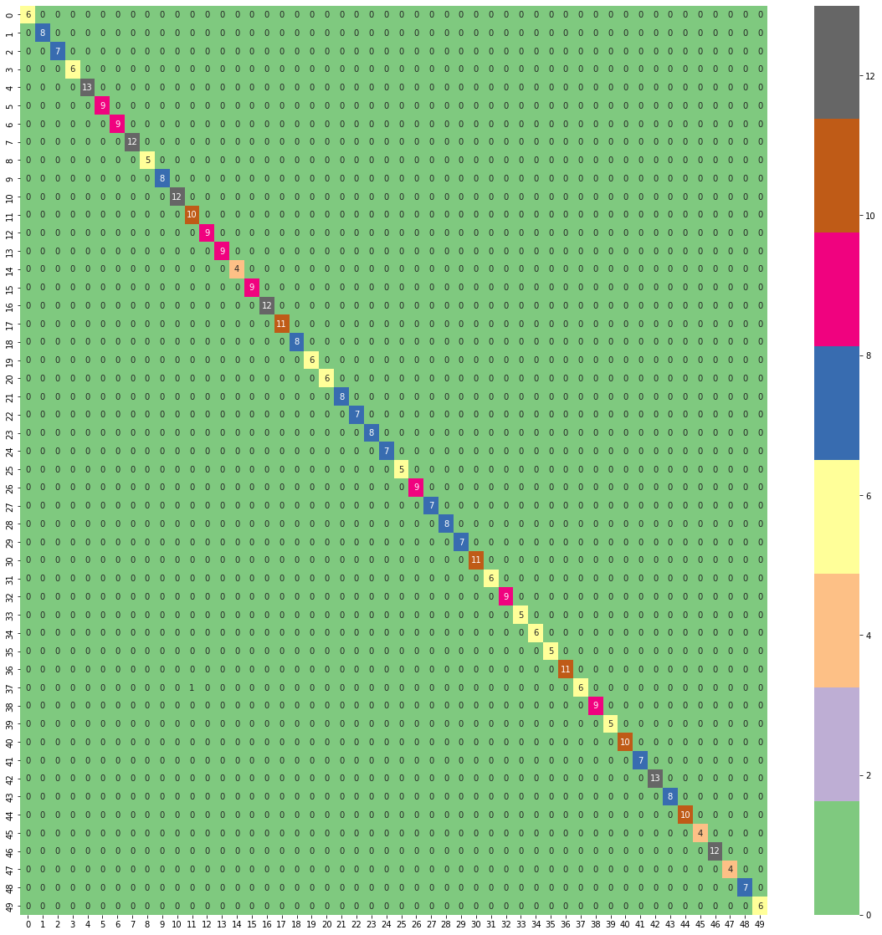
Confusion Matrix of MLP Classifier

Slide 21

Implementation Using Neural Network

Slide 22
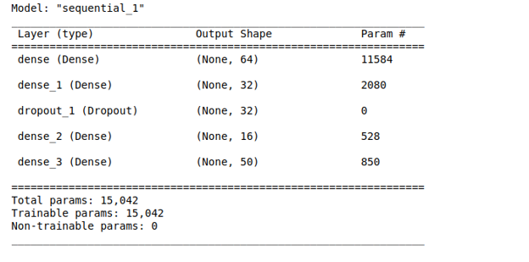
The Neural Network Architecture

Slide 23
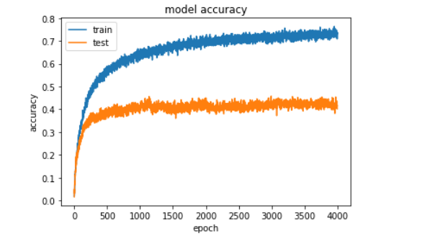
Accuracy

Slide 24
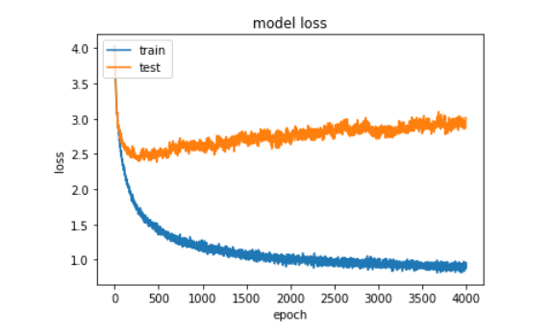
Total Loss

Slide 25
Model Deployment

Slide 26
Deployment using Streamlit
Streamlit is used to deploy the application
Joblib is used to save and load ML models – “.mdl”
SavedModel protocol buffer - Protobufs is used to save and load deep learning model – “.pb”

Slide 27
Demo
Link

Slide 28
Future Enhancements
Live Recording and classification
Large Audio File Inputs
Segmentation
More DL architectures can be built and tested

Slide 29
Thank You All
ICFOSS and Team especially Mr. Deepu (Project Guidance and Streamlit Session)

